Slide 1
bibliophile

Slide 2
Bibliophile – a website, where people can :
Discuss books with other users
Find out about the latest book releases
Search for books depending on their preferences
Find out where to purchase the selected book for the best price
Find out first in which bookstores there are discounts
Get special offers etc.

Slide 3
main users
Those who:
want to find specific literature according to their preferences
have troubles in finding adherents
kvell from reading

Slide 4



Aims of the project
UNITE PEOPLE WITH SAME INTERSTS
Expand the range of people who reAD BOOKS
MAKE SEARCHING MORE COMFORTABLE

Slide 5



architecture
python
design
AI
Use programming language to create a web-site
Make a convenient and aesthetic interface
Create an AI for analyzing books

Slide 6

Python is…
Python is a high-level, general-purpose programming language. Its design philosophy emphasizes code readability with the use of significant indentation.

Slide 7

Ai is…
Artificial intelligence (AI) is the ability of machines to perform tasks that are typically associated with human intelligence, such as learning and problem-solving.

Slide 8
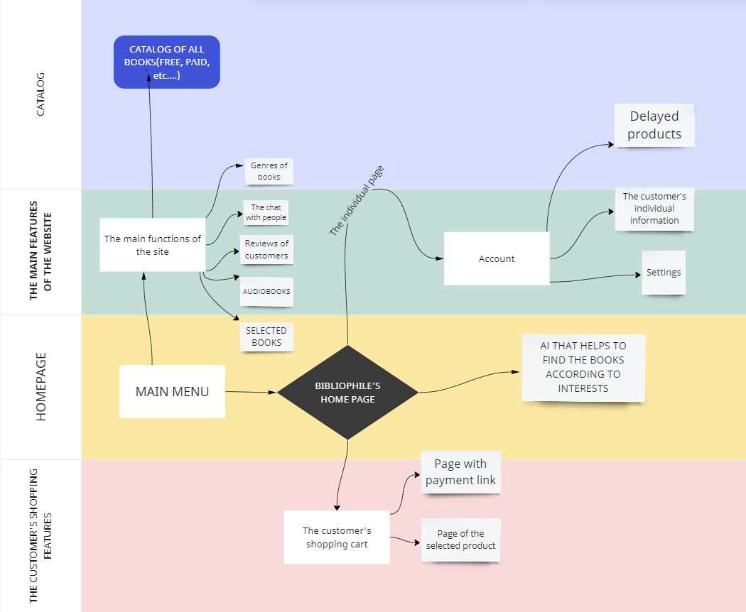
The structure of the site

Slide 9
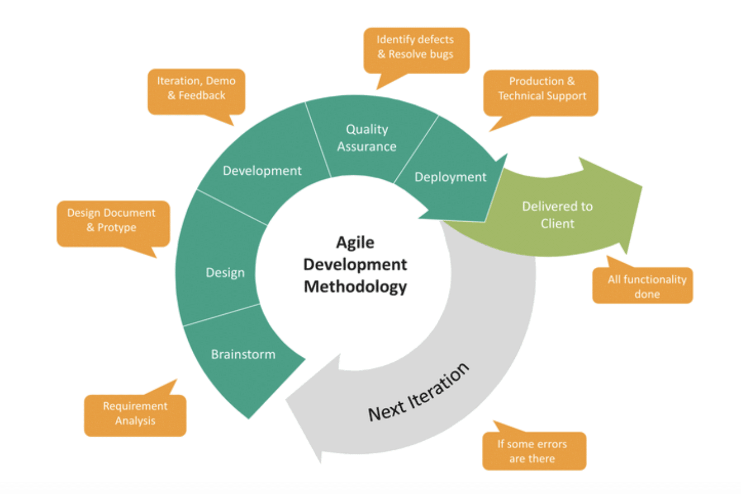
PLAN OF OUR WORK

Slide 10



Team members
Begunova milena
Timurshina alina
Shayakhmetova rezeda
Президент

Slide 11



Team members
Mubarakov islam
Favarisova alsu
Yandulina evgenia
Президент

Slide 12
Thanks for your attention

